Slide 1
Project Title : CAREER VISION
DEPARTMENT OF CSE-AIML (CSM) – IV-II Sem
FINAL PROJECT
Batch :1
TEAM MEMBERS: IV– II :: CSM-B
1. 21BQ1A4278
2. 21BQ1A42B1
3. 22BQ5A4209
4. 21BQ1A42A8
Project Guide:
K.BALA KRISHNA,
Assistant Professor,
Department of CSM,
VVIT

Slide 2
DEPARTMENT OF CSE-AIML (CSM) – IV-II Sem
FINAL PROJECT
Batch : 1
Project Description:
Develop an AI-powered career guidance system that provides personalized career pathways for students and professionals.
The system should consider an individual’s aptitude, aspirations, abilities, and work experience to recommend tailored career options and future progression opportunities.
Background: Career guidance is a critical component of educational and professional development, yet many individuals struggle to find the right career path that aligns with their skills, interests, and long-term goals.
Traditional career counseling methods often lack personalization and may not fully account for an individual’s unique profile, including their aptitude, aspirations, abilities, and past experiences.
This hackathon challenge invites participants to create an AI-enhanced career guidance system that leverages data to provide personalized, dynamic, and future-oriented career recommendations for students and professionals.
Aptitude Assessment: The system should include AI-driven tools to assess an individual’s natural aptitudes and strengths, identifying the areas where they are most likely to succeed and find satisfaction in their work.
Aspirations and Interests: Incorporate methods to capture and analyze the user’s career aspirations, interests, and values, ensuring that the recommendations align with their long-term goals and passions.
Ability and Experience Mapping: The system should evaluate the user’s current abilities, skills, and experiences, mapping these against potential career paths to identify where they stand and what further development might be needed.
Future Progression and Skill Gaps: Use predictive analytics to identify potential future career progression opportunities based on industry trends and individual growth potential.
User-Friendly Interface: Develop an intuitive, user-friendly interface that makes the career guidance process accessible and engaging for users at all levels, from students exploring initial career options to professionals considering a change or advancement.

Slide 3
DEPARTMENT OF CSE-AIML (CSM) – IV-II Sem
FINAL PROJECT
Batch : 1
Project Features
AI-Driven Aptitude Assessment
Personalized Career Pathway Recommendations
Skill and Experience Mapping
Interest and Aspiration Analysis
Gap Identification and Skill Development Suggestions
Natural Language Processing (NLP) Interface
Predictive Analytics for Career Progression
User-Friendly Dashboard
Feedback and Iteration Mechanism
Community and Networking Opportunities

Slide 4
DEPARTMENT OF CSE-AIML (CSM) – IV-II Sem
FINAL PROJECT
Batch : 1
Project Title: Career Vision
Project Tools Required:
. Frameworks :Python(3.8+)
. Front end: HTML, CSS, JavaScript
. Backend: Flask
. Business logic/models: ML,DL
. Hardware specifications: Mini capacities for execution of the
proposed system
Operating System: Windows 10x or Higher Versions
RAM: Minimum 4 GB
HDD (Storage): Minimum 1 TB
Graphics Card: Minimum 1 GB
Network Bandwidth: 512 kbps (required for cloud computing or AWS-based deployment)

Slide 5
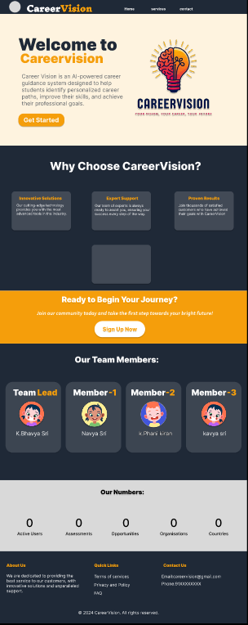

Slide 6
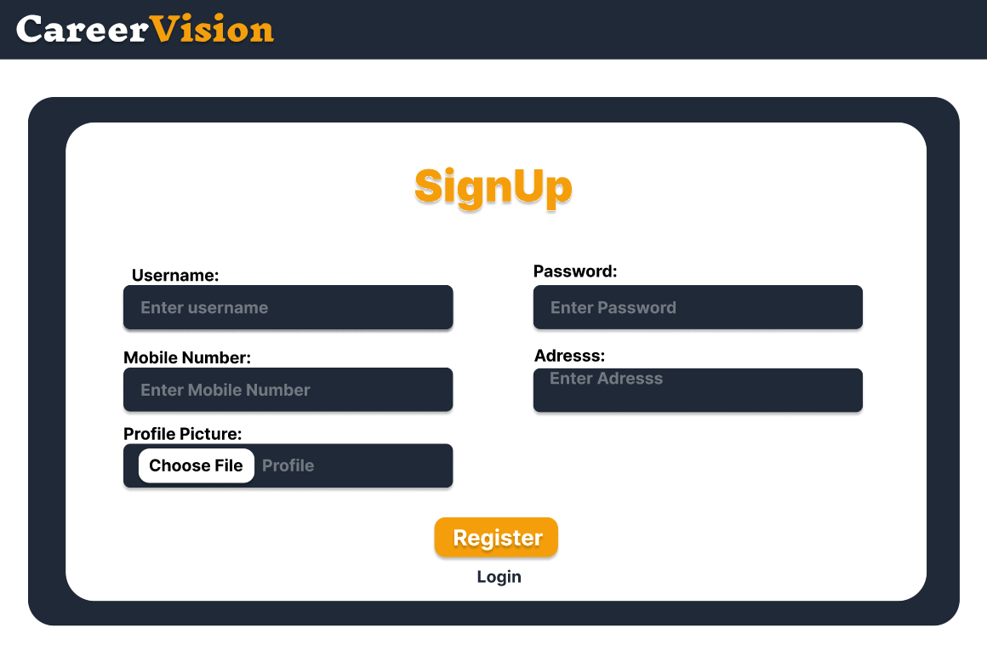

Slide 7
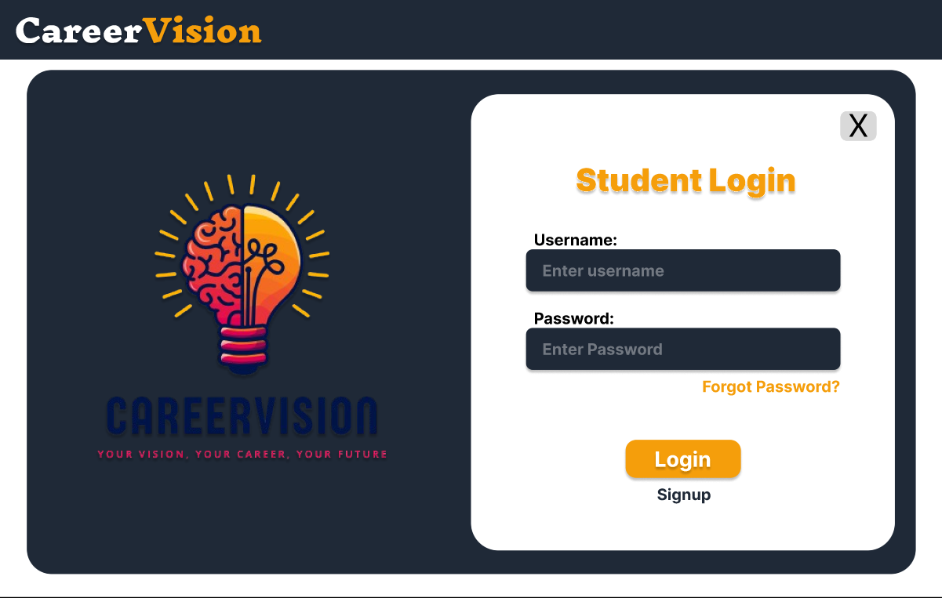

Slide 8
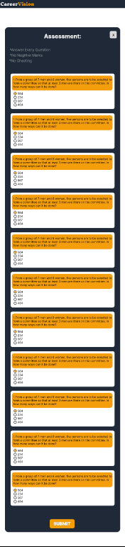

Slide 9
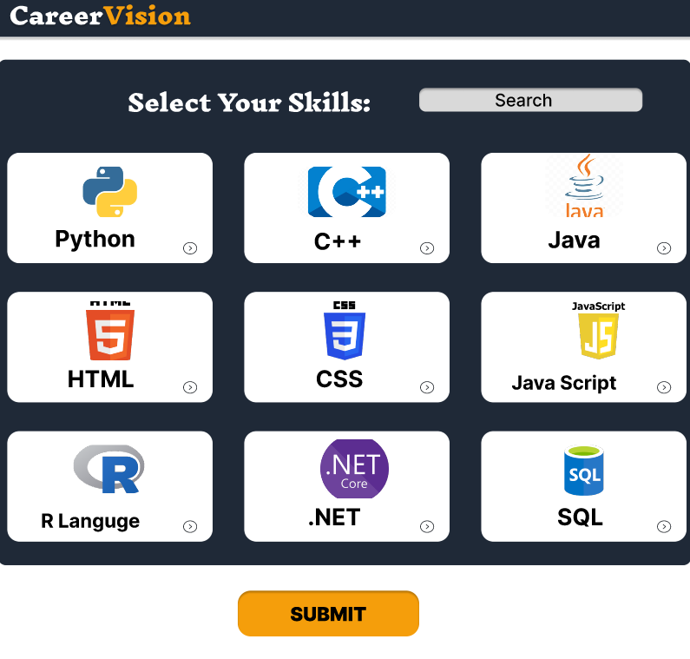

Slide 10
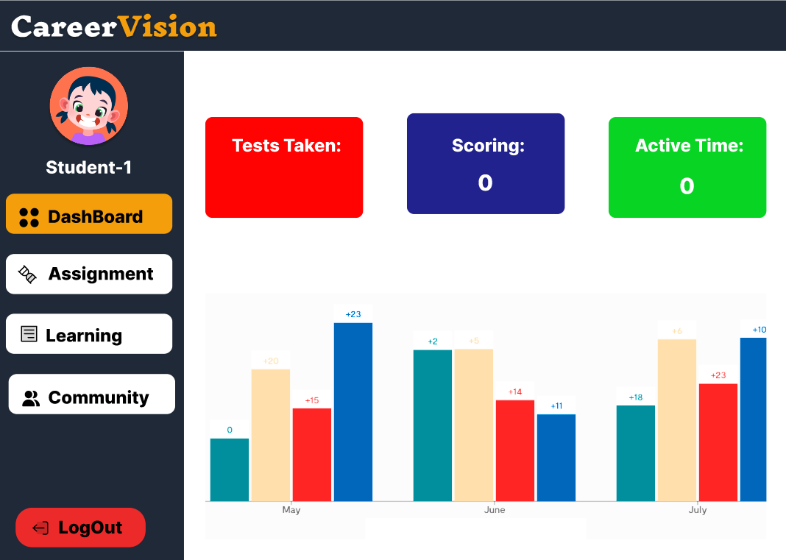

Slide 11
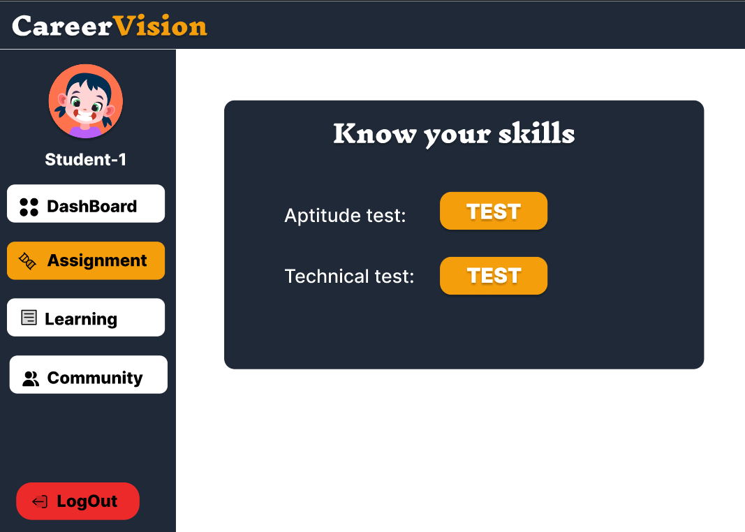

Slide 12
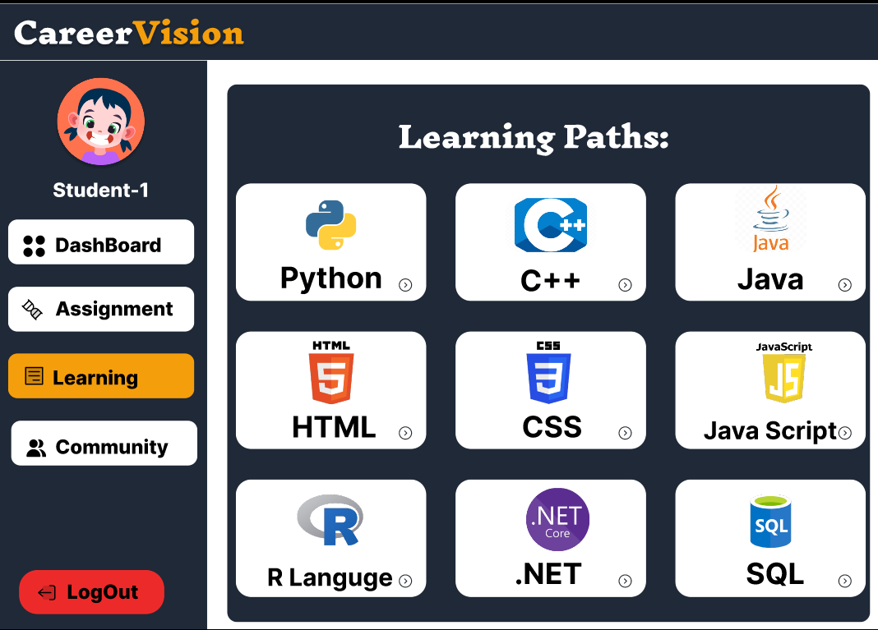

Slide 13
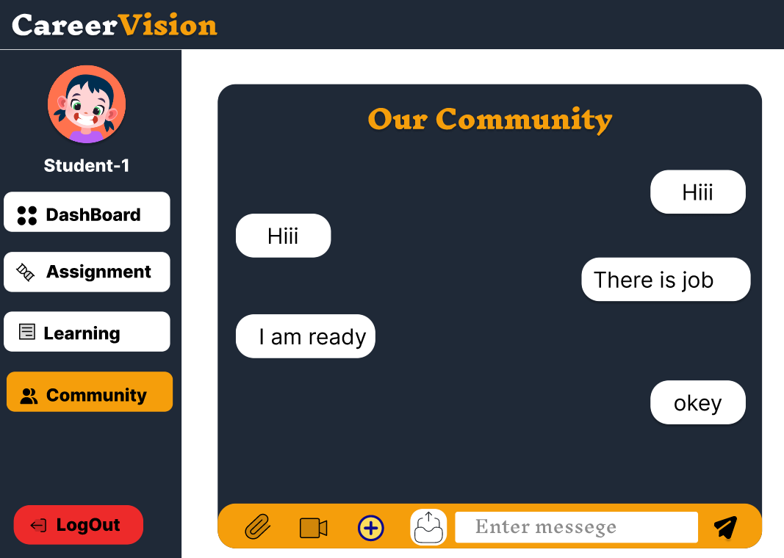

Slide 14
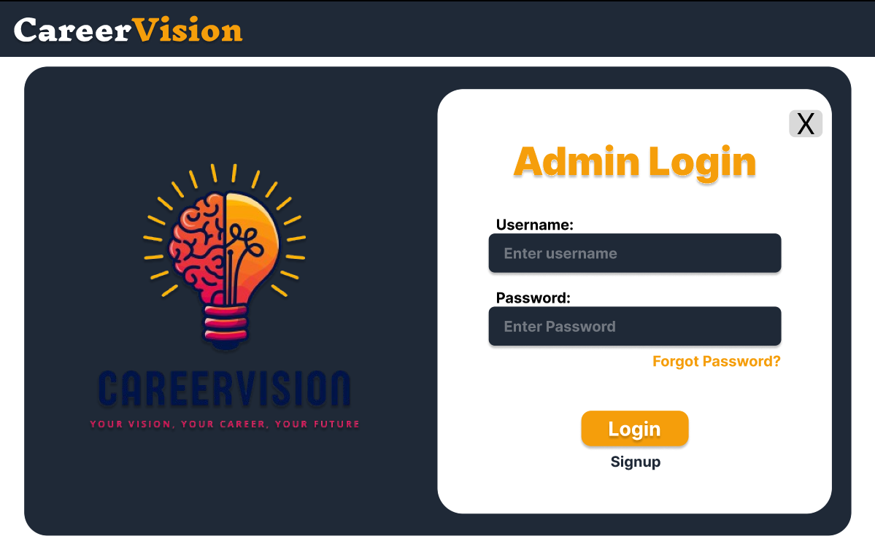

Slide 15
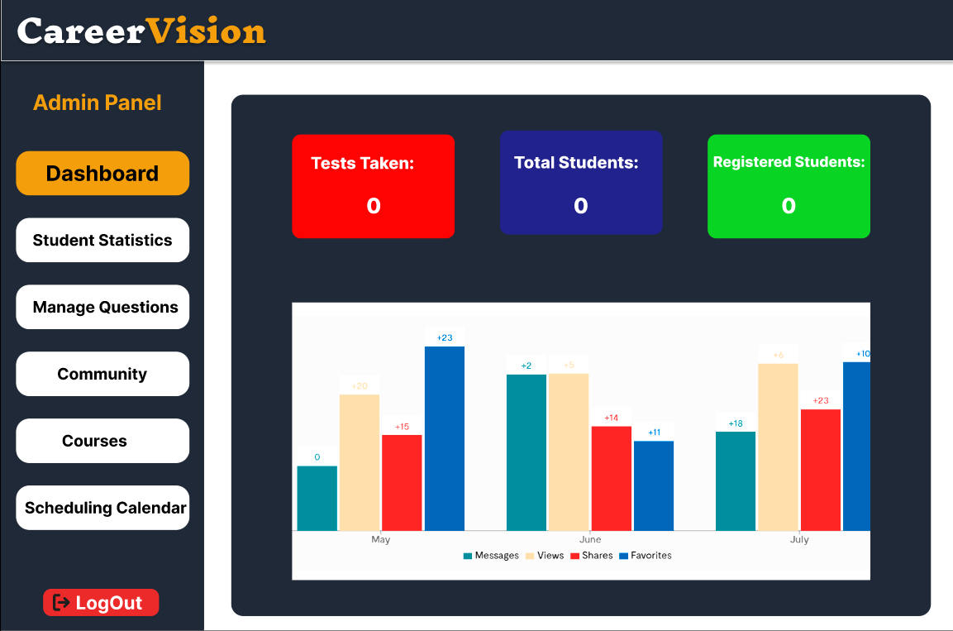

Slide 16
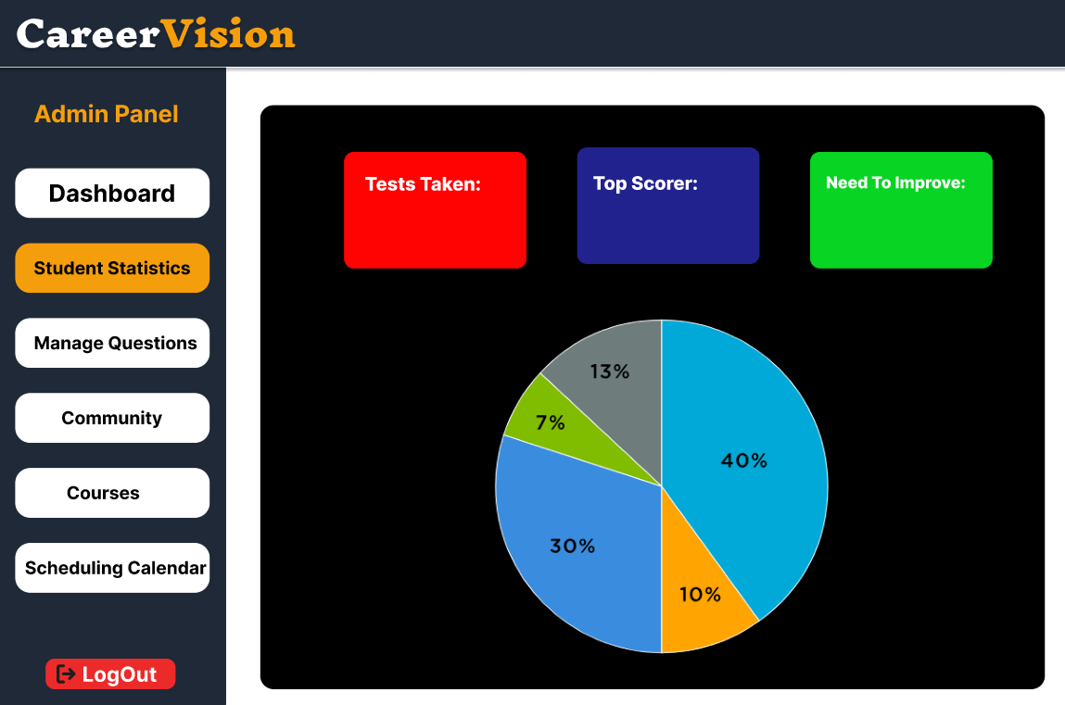

Slide 17
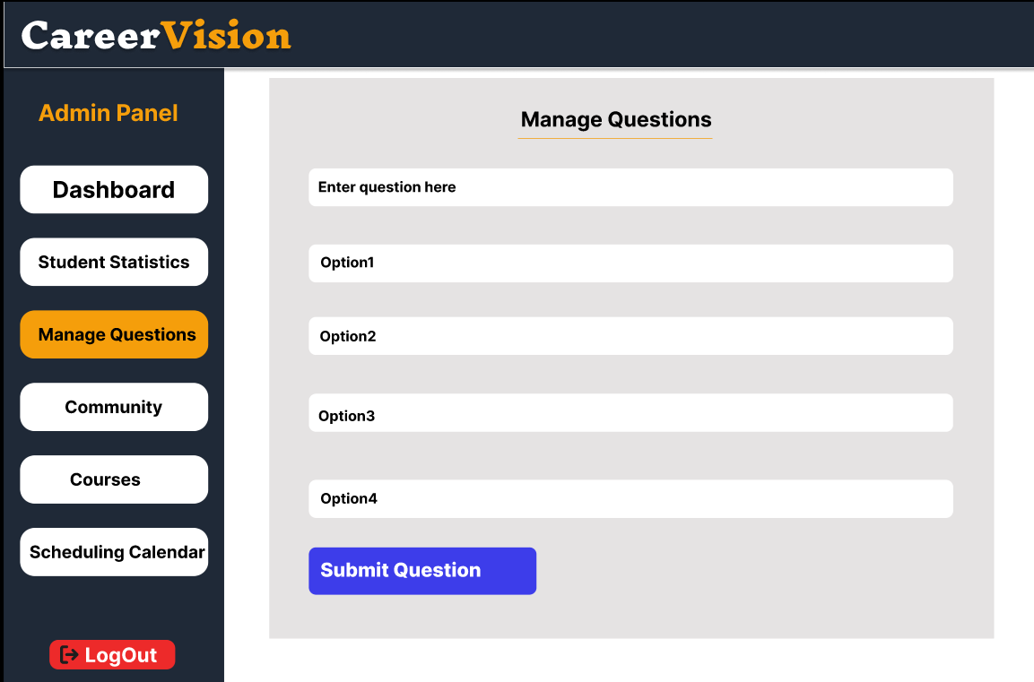

Slide 18
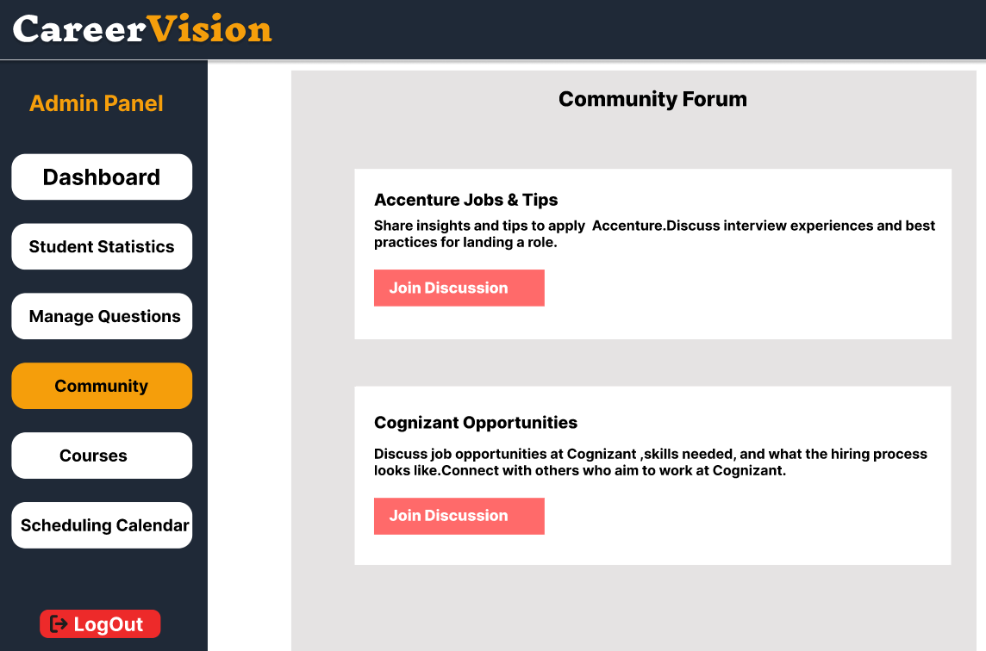

Slide 19
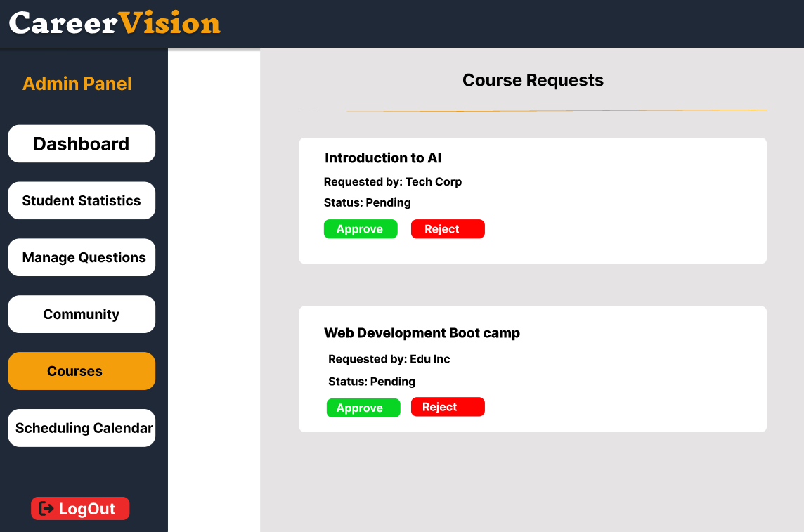

Slide 20
